Slide 1
Book Recommendation System
Project final presentation
Group 3
Avi Mudgal and Manasi Sardesai

Slide 2
Project Overview
Problem Statement
Project Development Stages
Introduction to Recommendation System
Dataset Information
Data Preprocessing and EDA
Data Visualization
Different Recommendation Techniques
Model Building
Model Deployment
Challenges and Future Scope

Slide 3
Problem Statement
In today’s digital landscape, users get overwhelming choices across various platforms.
OTT: Netflix, Hotstar, Amazon Prime ; Apparel: Myntra, Zara, Ajio ; Mobile: Apple, Samsung
Makes personalized recommendations essential.
Project aims to perform a Book Recommendation System:
Compile a comprehensive books dataset
Clean and analyse
Implement various recommendation systems
Deploy the models to create an interactive platform for real-time recommendations

Slide 4
Project Development Stages
Project Stages
Problem statement
Data
Collection
Data Preprocessing and
EDA
Data Visualization
Model Development
Deployment
This project provides a structured approach for a developer to develop data-driven solutions that address specific business problems.
By following the steps outlined in the figure ensure that their projects are completed efficiently and effectively.
This methodology enables data scientists to deliver high-quality solutions that provide real value to the business.

Slide 5
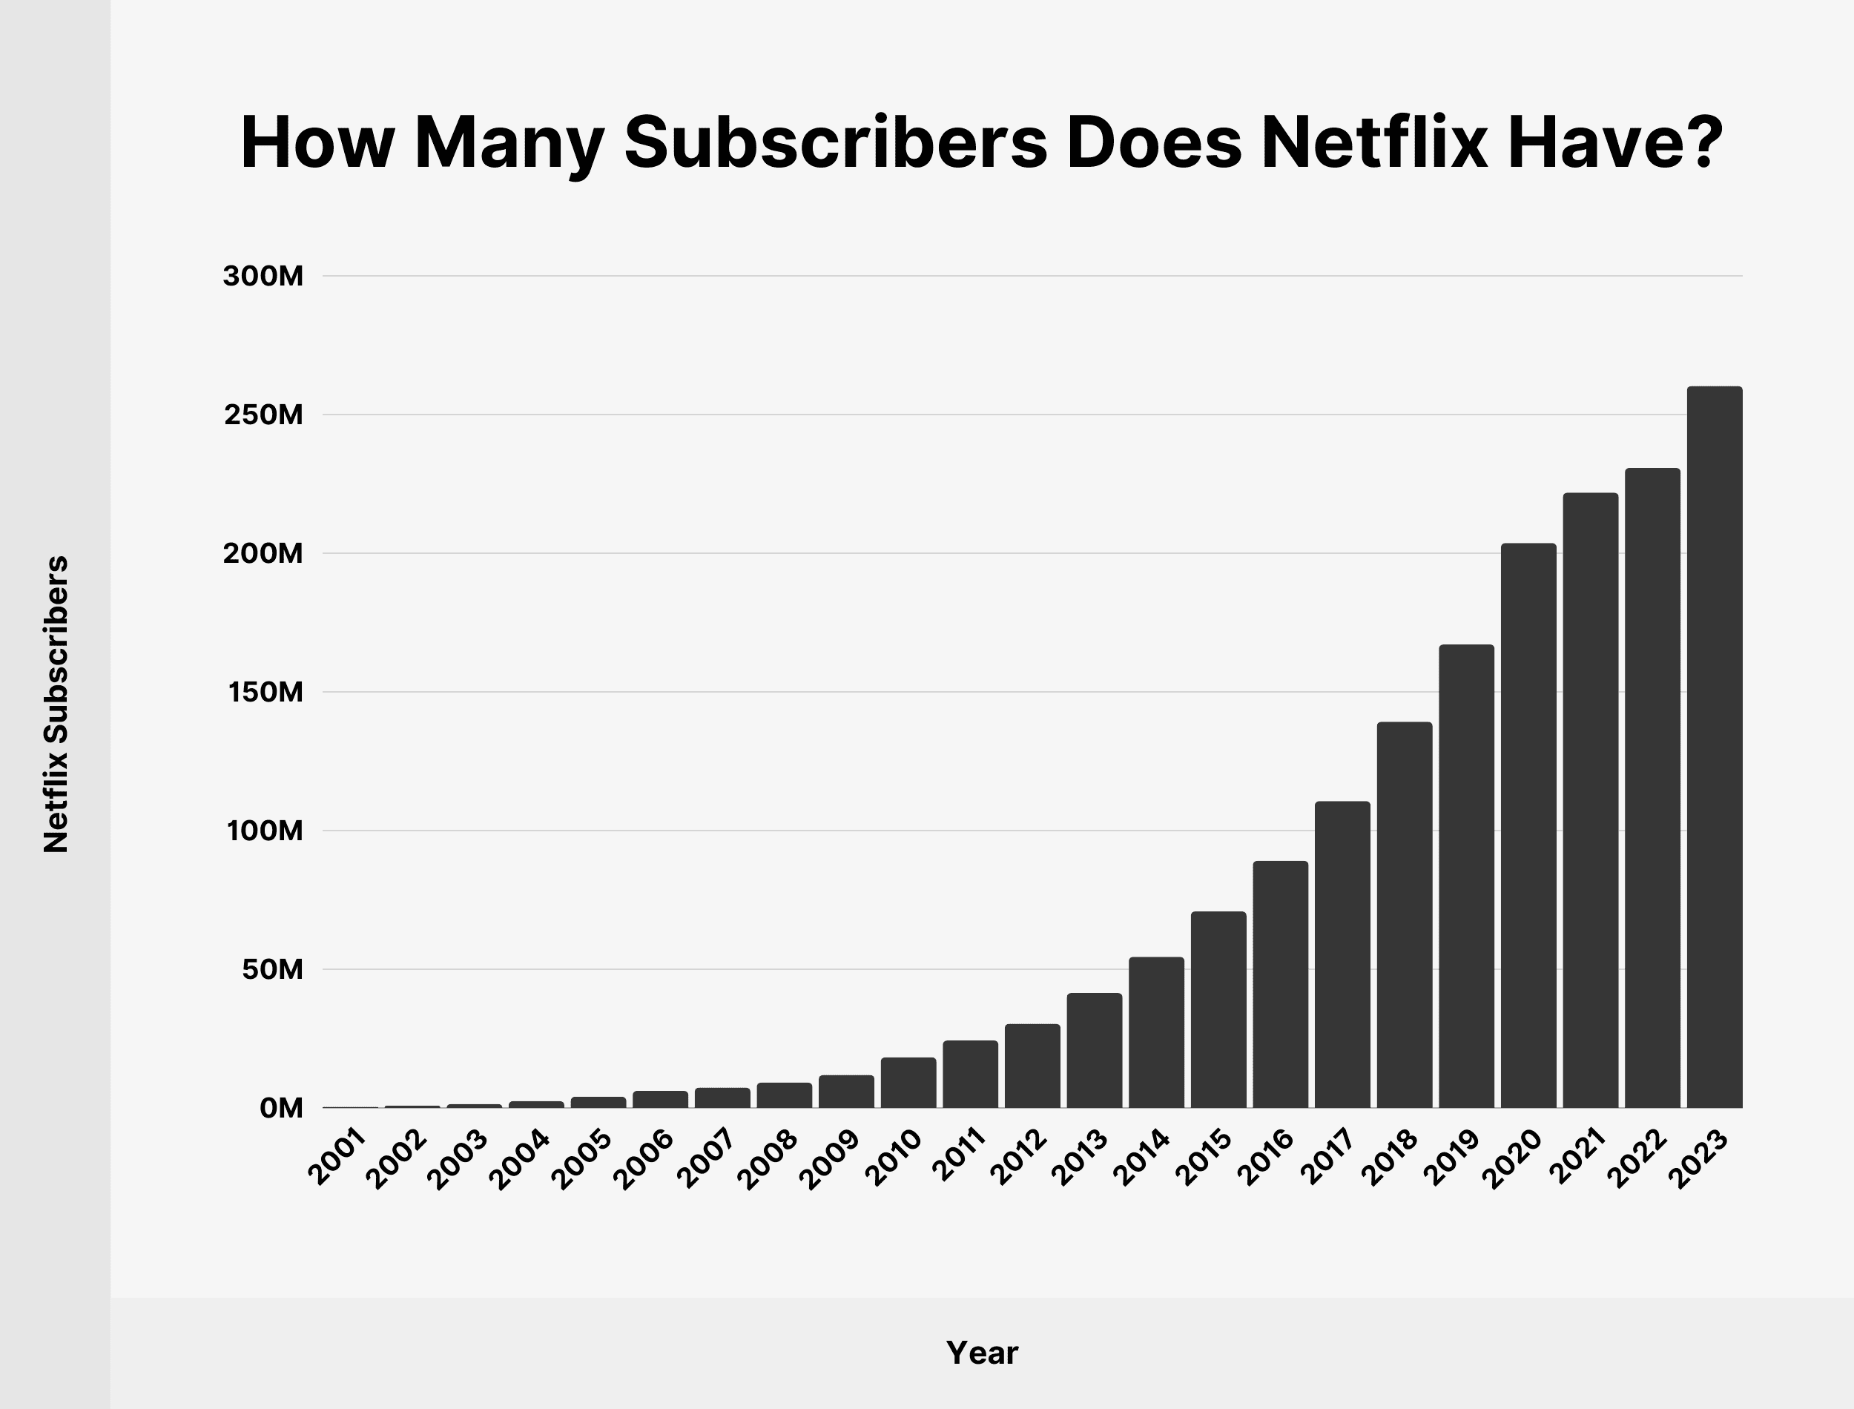
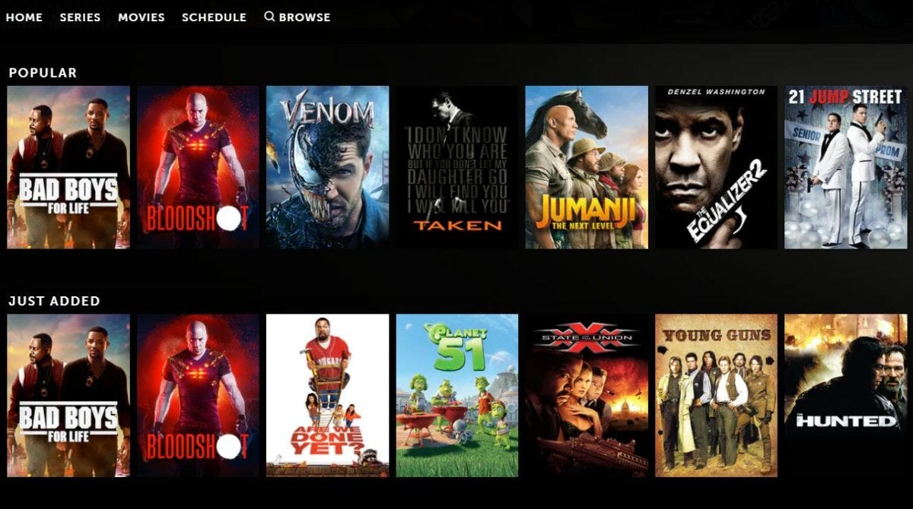
Introduction to Recommendation System
A system that predicts the future preference for a set of items for user on top of priority.
People from different background have variety of options to web services
General area of application:
Recommendation system increases the audience interest and sales for the company.
Eg : Netflix users
Images Courtesy: Netflix Website

Slide 6
Dataset Information
Books Dataset
Categorical Features
Title
Author
Numerical Features
Rating
Summary
Genre
Language
City
Publisher
Link
Year of Publishing
ISBN
Source: www.openlibrary.org/
Dataset size: 8080 rows x 11 columns

Slide 7
Dataset Extraction
Perform web scraping using BeautifulSoup
Pip install bs4 and import BeautifulSoup.
Get the HTML text of URL using requests() function and perform BeautifulSoup over it.
Write 2 functions:
Function_1: To extract information (features) from individual book
Function_2: To extract all the books from a single page
Write a for-loop to extract all books from total no. of pages.
Save the result as a Pandas data frame.

Slide 8
Data Preprocessing and EDA
Categorical Features
Value counts for each feature
Number of books by Genre
Numerical Features
Statistical description of rating and year
Histograms of distribution of books by year and rating
Top 100 authors and publishers by books
Number of books by Language
Box plot of ratings, check for outliers
Scatter plot: Year vs. Ratings
Correlation matrix: Year vs. Ratings
Check for null values
Check for null values

Slide 9
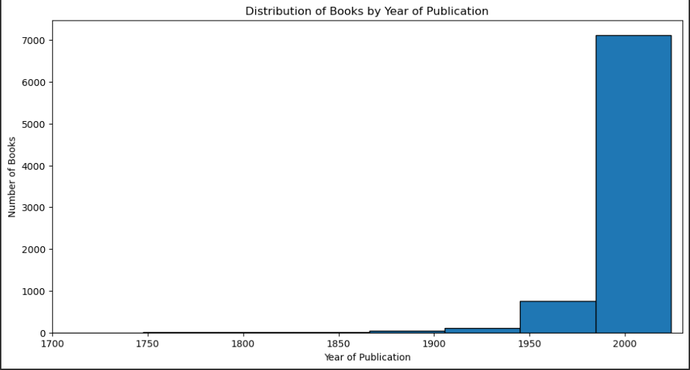
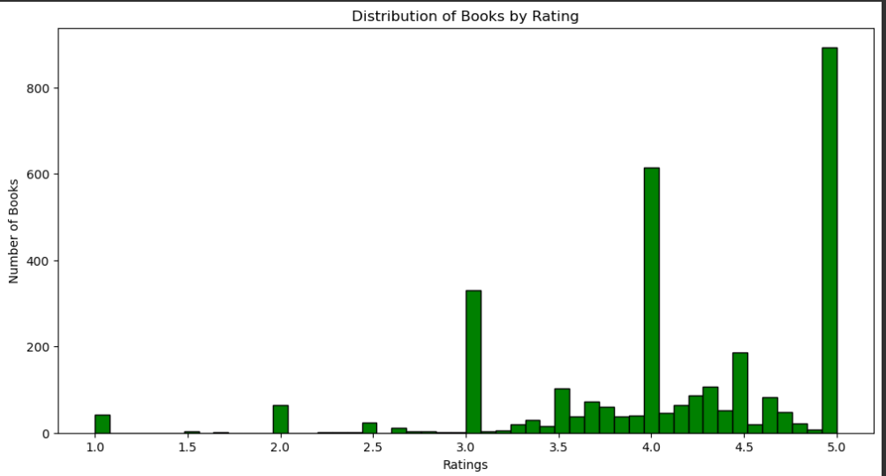
Data Visualization

Slide 10
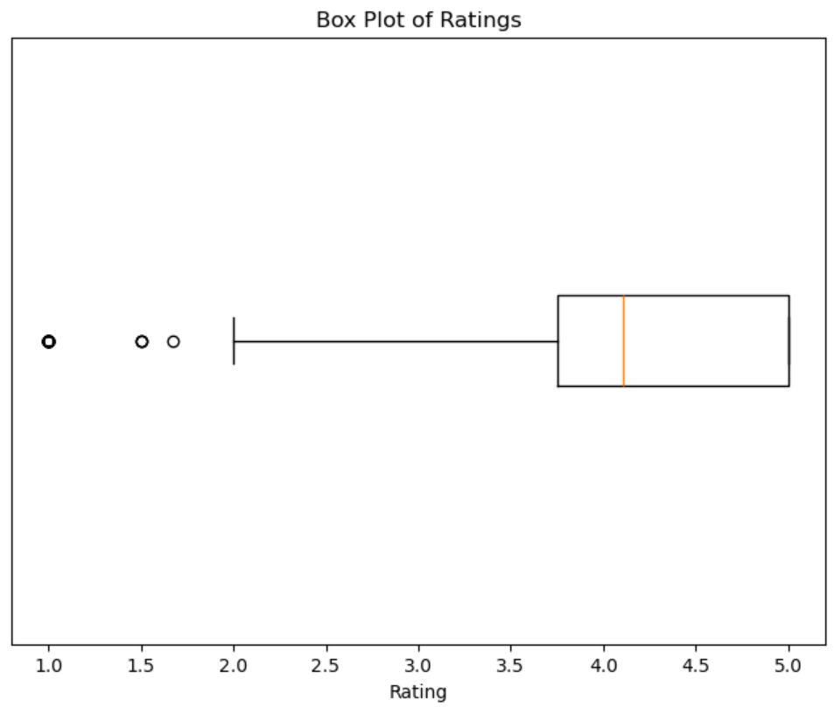
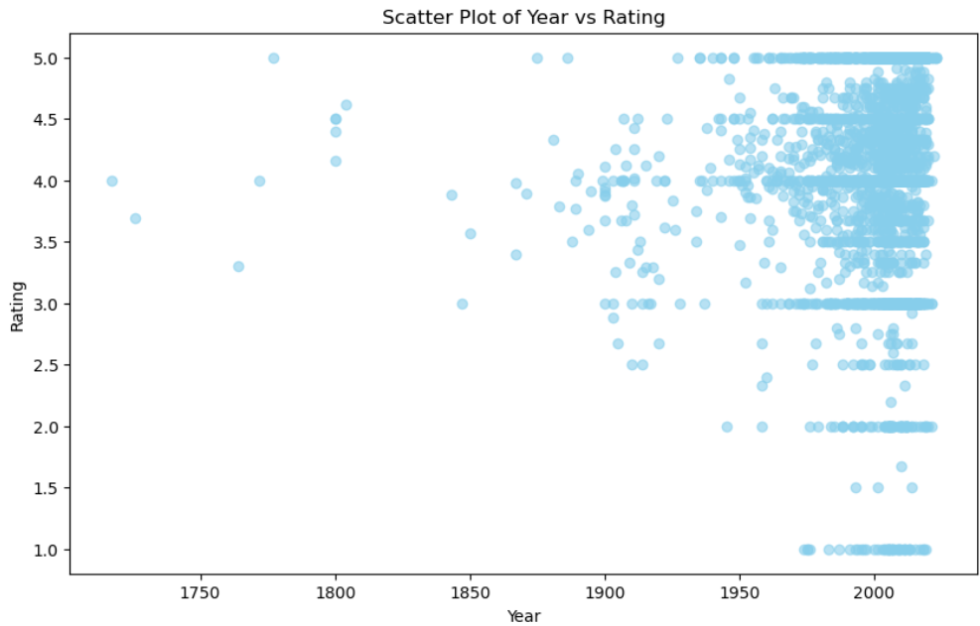
Data Visualization

Slide 11
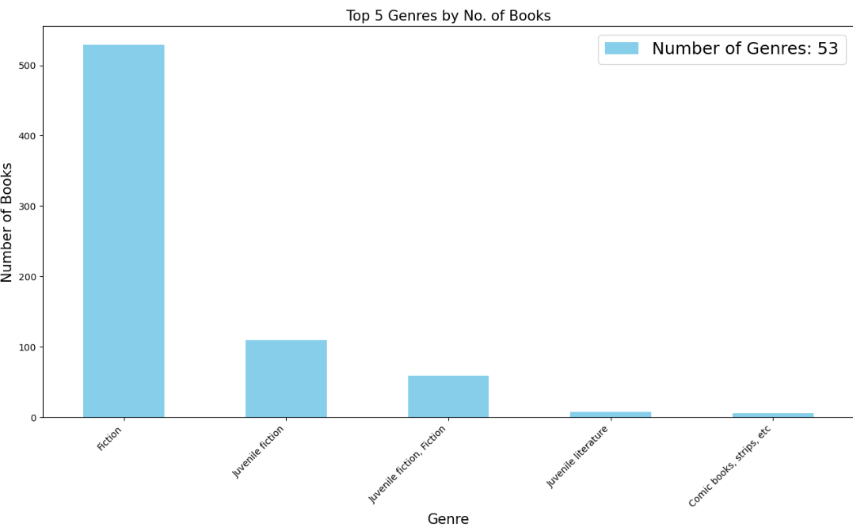
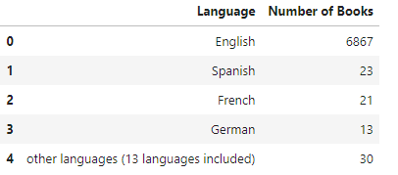
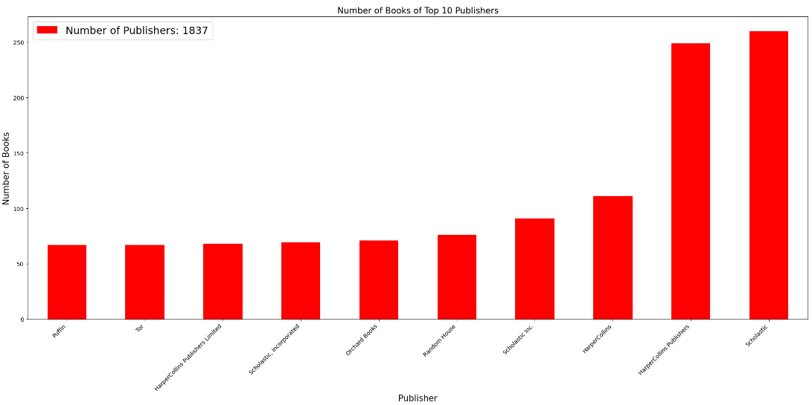
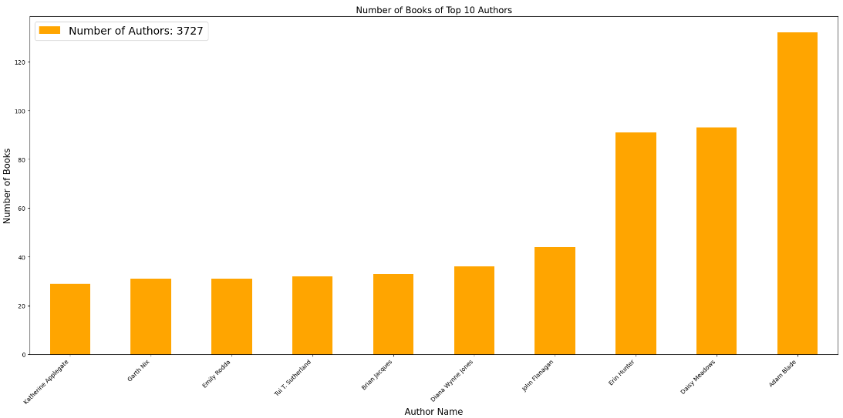
Data Visualization

Slide 12
Different Recommendation Techniques
Content-Based Recommendation System
Collaborative-Based Recommendation System

Slide 13
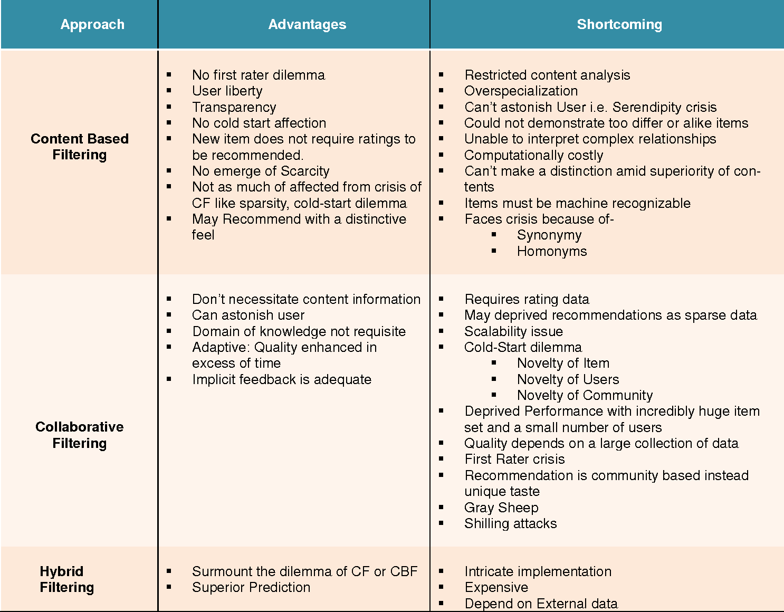

Slide 14
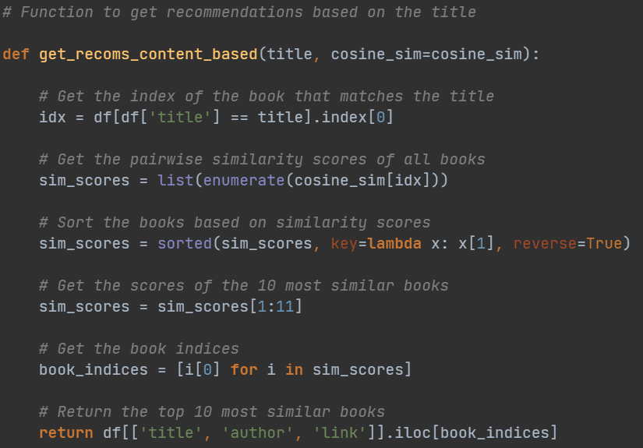
Model Building
Content-based Recommendation Model
Based on similarity of content.
Features used for similarity measurement: Genre, Summary, Publisher.
Combine all three features into a single column “Combined”.
Create TF-IDF matrix using TfidfVectorizer() function.
Compute cosine similarity matrix using linear_kernel() function.
Write a function to get the recommendations where,
Input: Book title
Output: Top 10 Recommendations – Title, Author and Link

Slide 15
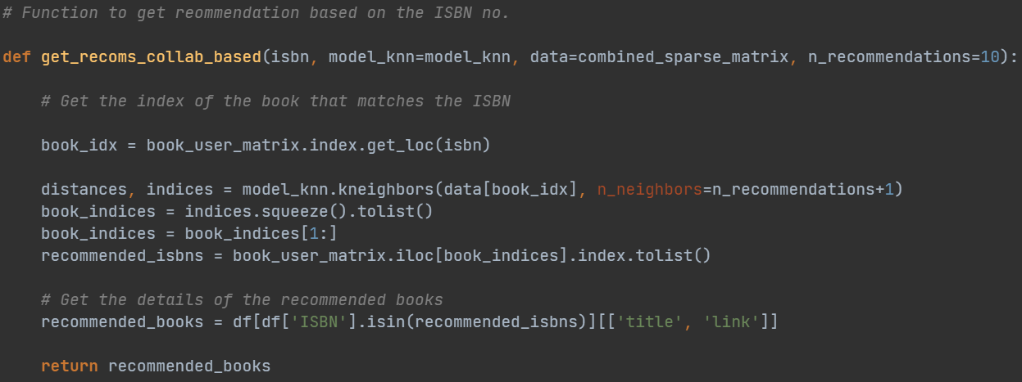
Model Building
Collaborative-based Recommendation Model
Based on user interaction and filtering with respect to categorical features and numerical features.
Create dummy user interaction of 100 users.
Assign random ratings ranging to users from 1 to 5.
Use ISBN as index for user interaction and create a DF.
Perform label encoding over categorical features.
Normalize numerical features using MinMaxScalar.
Create pivot table for user interactions.
Align the pivot table with books dataset.
Create sparse matrix for book-user interactions.
Combine encoded features to the sparse matrix.
Fit the KNN model over the matrix.
Write a function to get recommendations where,
Input: ISBN
Output: Top 10 Recommendations – Title, Link

Slide 16
Model Building
Popularity-Based Recommendation Model
Filtering to display Top 50 books of Modern Era (Years 2000 and above) and Pre-Modern Era (Years below 2000).
Criteria: Highest average rating.
Perform sorting by rate, books with same rating further sorted by year.

Slide 17
Model Deployment
Model Presentation: Present the ML model in a product environment to make it user-friendly and accessible.
Deployment: Placing the application/model in front of real users for use.
Streamlit: Open-source Python framework that delivers dynamic data apps, integrating with Python IDE (PyCharm, Spyder, etc.)

Slide 18
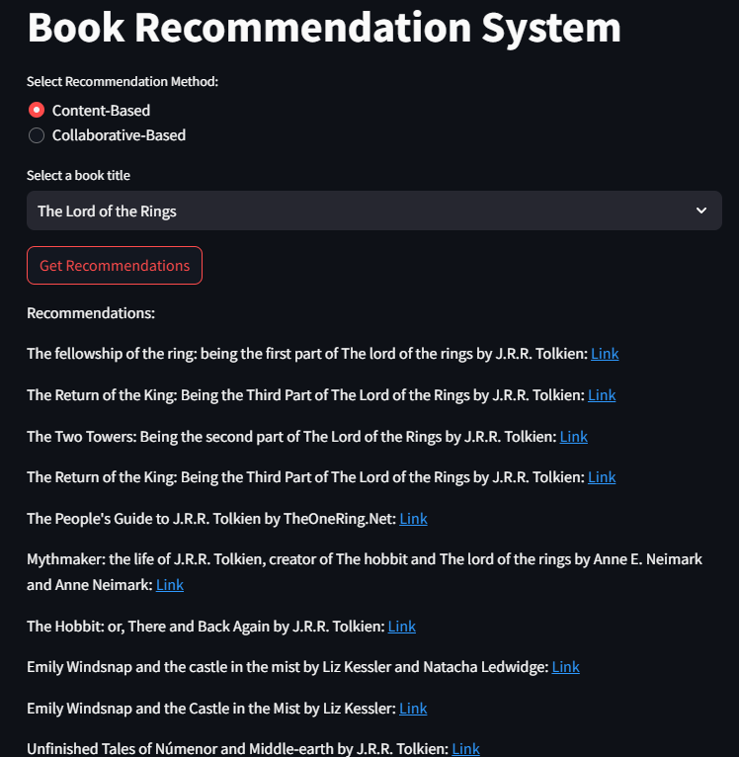
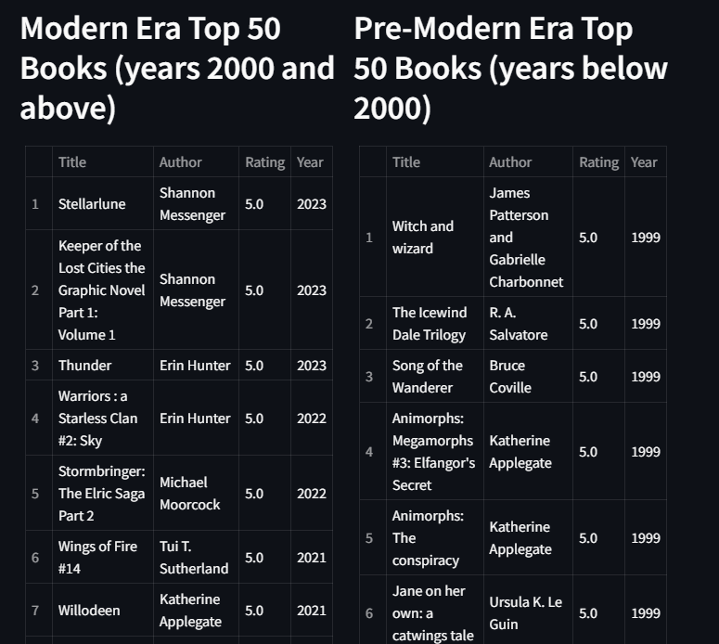
Model Deployment

Slide 19
Challenges
Understanding and applying BeautifulSoup for web scraping.
Selection of features for EDA and data visualization.
Model building technique: coding and testing
Model accuracy remains the big and unexpected challenge!
Rigorous discussions on using Streamlit and learning to implement.

Slide 20
Future Scope
Debug issues encountered while determining model accuracy (precision, recall, f1-score).
Collaborative-filtering: Display of book title for users instead of ISBN in the input, better understanding of the selected book.
Developments in model deployment, interactive, appealing with added features.

Slide 21
Thank you !!

